Slide 1
Serum NMR Metabolomics
Test Report
Comprehensive, Precise, and Layered System Solutions
Q.One Instruments Ltd.

Slide 2
01
Strategic Overview of Serum Metabolomics
Contents
Report
Contents
02
Three Complementary NMR Protocols
Serum NMR Metabolomics Test Report — analytical
framework and key findings.
03
Synergistic Value in Biomarker Discovery
Notes:
This report is structured into three main sections. First, we will overview the strategic role of serum in metabolomics. Second, we will deep dive into the three complementary NMR protocols: NOESY for global profiling, CPMG for small molecules, and DOSY for lipid characterization. Finally, we will discuss how these methods integrate to provide a complete metabolic picture.

Slide 3
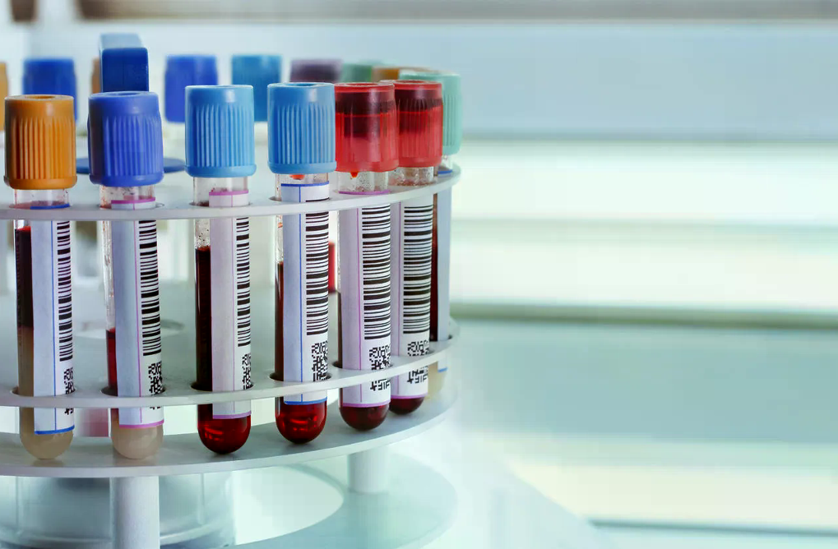
The Value of Serum Metabolomics
Serum is the core sample for clinical testing and biomarker discovery. The depth and breadth of
metabolomic analysis directly determine research quality.
Core Sample
Serum reflects systemic metabolic states, making it ideal for non-invasive diagnostics and disease
monitoring.
Quality Determinant
The comprehensiveness of metabolite coverage directly impacts the reliability of biomarker identification.
Serum sample tubes in clinical laboratory
NMR Advantage
Layered Approach
High-field NMR offers high reproducibility, minimal sample preparation, and simultaneous detection of diverse metabolite classes.
A single spectrum is often insufficient; a multi-pulse strategy is required to resolve complex overlapping signals.
Notes:
Serum contains a wealth of metabolic information that reflects the physiological and pathological state of the body. However, this information is complex and layered. Traditional single-method approaches often miss critical details. Our solution leverages high-field NMR to establish a layered detection system that captures everything from global metabolic profiles to specific lipid subclasses.

Slide 4
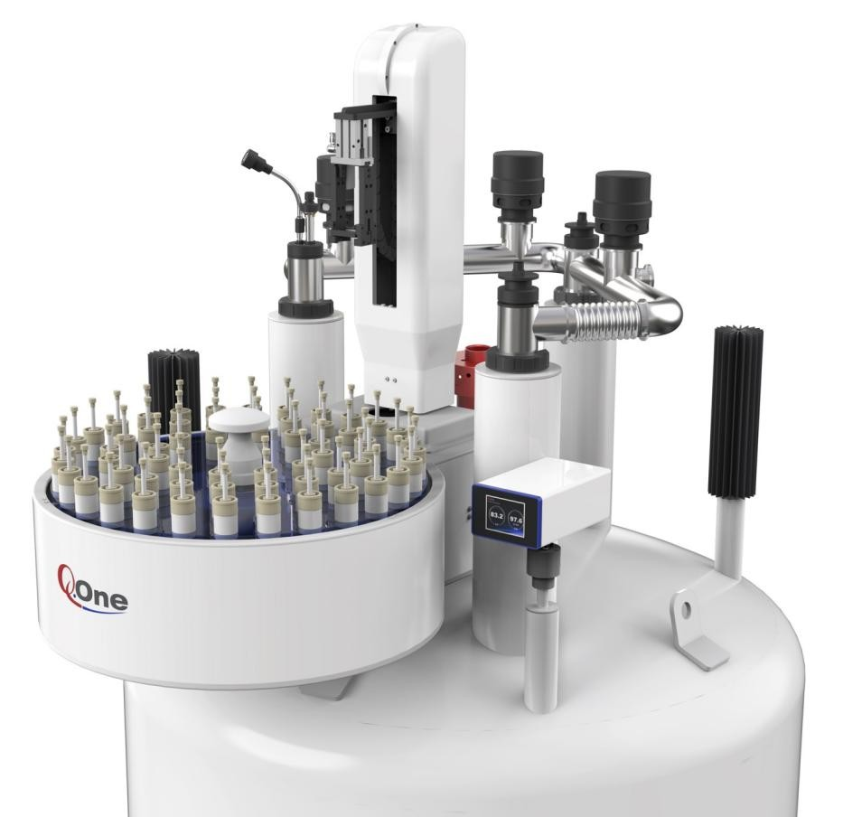
Protocol 1: NOESY-GPPR1D
Global Metabolic Profile
NOESY-GPPR1D provides a rapid, comprehensive fingerprint of all proton-containing metabolites in serum. It covers
both small molecules and lipid signals, making it the preferred choice for initial sample quality assessment and global
metabolic overview.
01
Comprehensive Coverage — Simultaneously detects small molecules (amino acids, glucose) and macromolecules (lipoproteins).
02
Fingerprinting — Serves as a 'metabolic ID' for each sample, useful for cohort
clustering and outlier detection.
03
Water Suppression — Effectively suppresses the intense water signal to reveal low-concentration metabolites nearby.
04
Application — Ideal for initial screening, sample integrity verification, and broad metabolic phenotyping.
High-field NMR spectrometer — hardware platform for serum metabolomics profiling
Notes:
The first protocol is NOESY-GPPR1D. This is our 'global view' method. It acquires a comprehensive fingerprint of all proton-containing metabolites in the serum, including both small molecules and lipids. It's primarily used for sample quality control and getting a quick overview of the subject's metabolic status. As you can see in the spectrum, it captures the full range of signals.

Slide 5
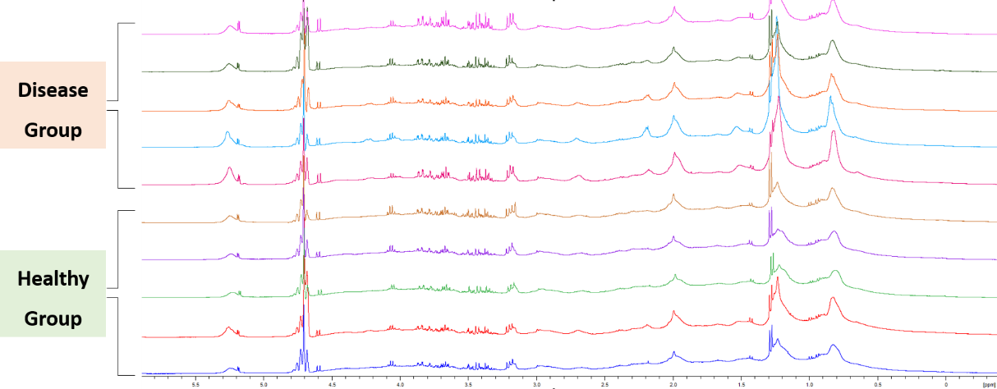
Serum Samples (50%D2O): NOESY-GPPR1D
400MHz Quantum-I Plus, high sensitivity STM probe, SpinStudioJ2.8.0

Slide 6
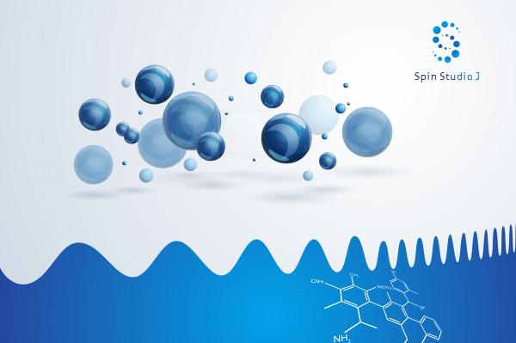
Protocol 2: CPMG-T2 (Small Molecule Profile)
CPMG-T2 utilizes spin-echo filtering to suppress broad signals from proteins and lipoproteins. This technique selectively highlights small molecule metabolites like lactate, glucose, and amino acids, enabling the precise capture of subtle metabolic variations.
Macromolecule Suppression
Enhanced Resolution
Exploits T2 relaxation differences to filter
out signals from albumin and globulins.
Reveals sharp peaks of low-molecular-
weight metabolites otherwise obscured in
standard 1D spectra.
Metabolic Sensitivity
Key Targets
Highly sensitive to acute metabolic
changes, such as glycolysis or oxidative
stress markers.
Focuses on water-soluble metabolites
including organic acids, sugars, and
nitrogenous compounds.
NMR spectroscopy laboratory — researcher operating analysis equipment
Notes:
The second protocol is CPMG-T2. Serum is rich in proteins and lipids, which create broad background signals that can mask small molecules. CPMG uses a spin-echo filter based on relaxation times. Small molecules tumble fast and retain their signal, while large macromolecules relax quickly and are suppressed. This allows us to clearly see lactate, glucose, and amino acids, capturing subtle metabolic shifts.

Slide 7
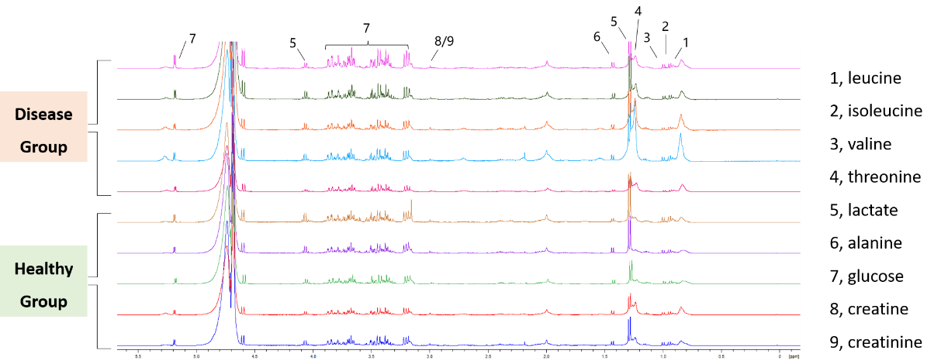
Serum Samples (50%D2O): CPMGT2
400MHz Quantum-I Plus, high sensitivity STM probe, SpinStudioJ2.8.0

Slide 8
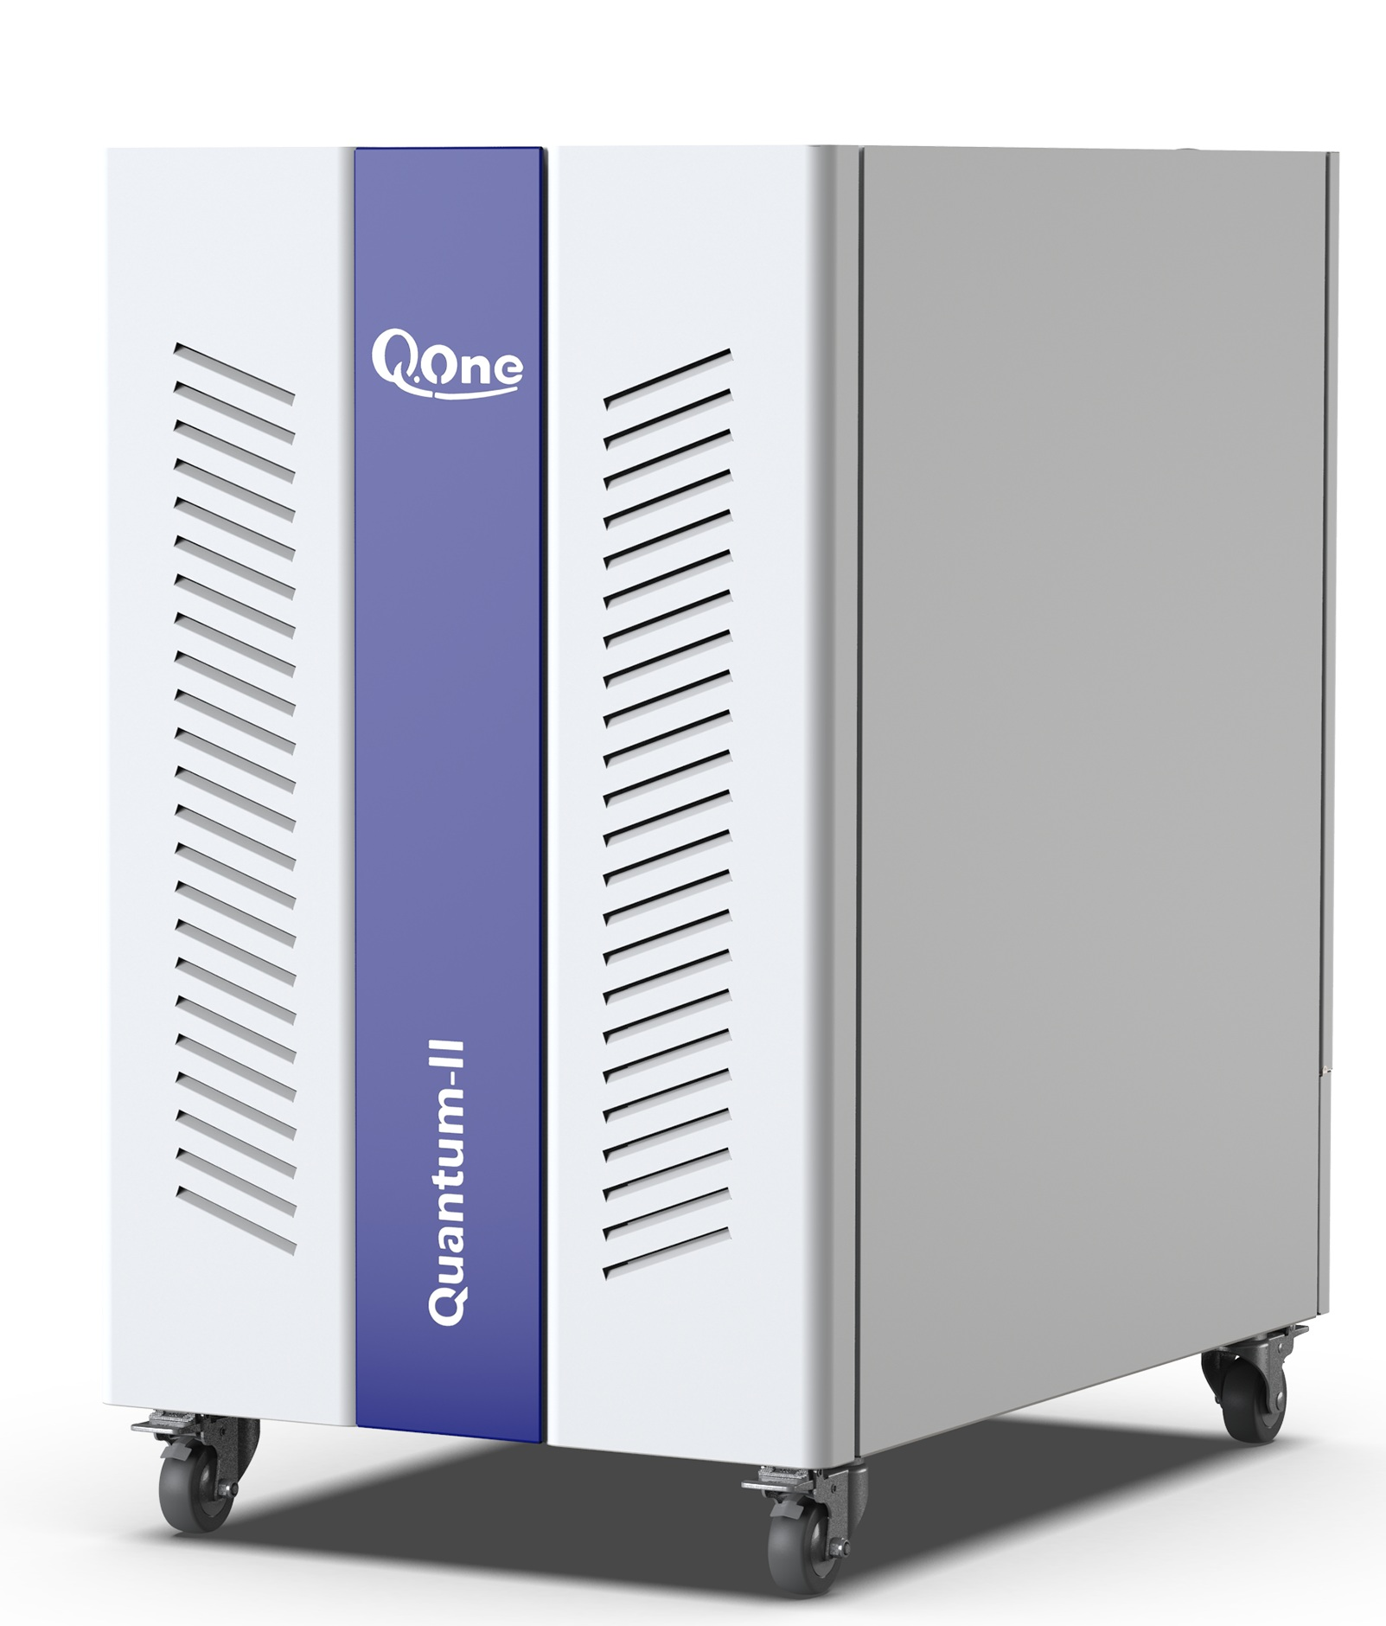
Protocol 3: DOSY-1D (Lipid Metabolic Profile)
DOSY-1D differentiates lipoprotein subclasses and fatty acid compositions based on molecular size and diffusion
coefficients, enabling layered characterization of blood lipids for cardiovascular and metabolic disease research.
01
Size-Based Separation — Resolves signals from VLDL, LDL, and HDL particles
based on their distinct diffusion rates.
02
Lipid Composition — Analyzes the degree of unsaturation and chain length of fatty acids within specific lipoprotein fractions.
03
Non-Invasive Fractionation — Achieves virtual chromatography without physical separation or chemical extraction.
04
Clinical Relevance — Critical for assessing cardiovascular risk profiles beyond
standard cholesterol measurements.
Blood lipid analysis · Laboratory sample
Notes:
The third protocol is DOSY-1D, or Diffusion Ordered Spectroscopy. This method separates signals based on molecular size and diffusion coefficients. In serum, lipids exist in different lipoprotein particles like VLDL, LDL, and HDL. DOSY can distinguish these subclasses and their fatty acid compositions without physical separation. This provides a unique perspective for cardiovascular and metabolic disease research.

Slide 9
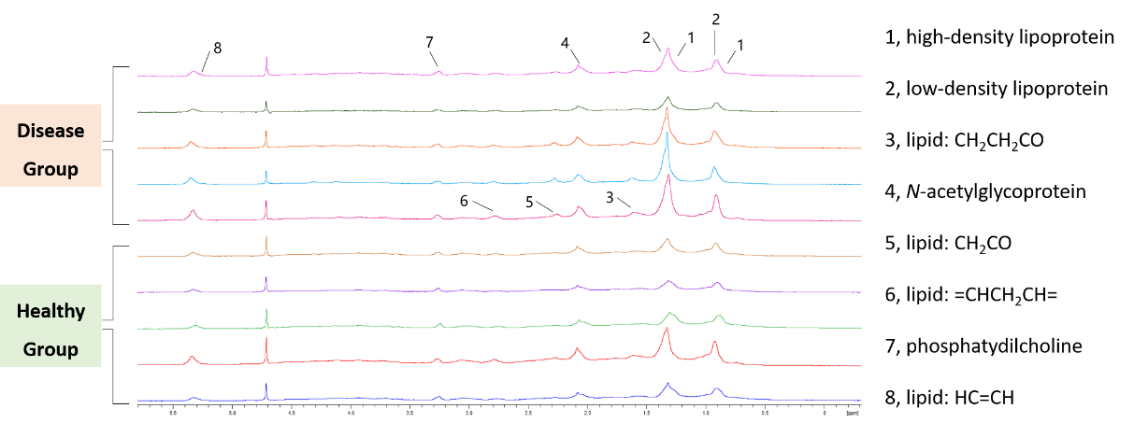
Serum Samples (50%D2O): DOSY1D
400MHz Quantum-I Plus, high sensitivity STM probe, SpinStudioJ2.8.0

Slide 10
Integrated Metabolomic System
The three NMR protocols—NOESY, CPMG, and DOSY—are complementary and mutually reinforcing. They
collectively construct a complete serum metabolomics analysis system ranging from macroscopic global profiles to
microscopic lipid details.
PROTOCOL 01
PROTOCOL 02
PROTOCOL 03
NOESY-GPPR1D
CPMG-T2
DOSY-1D
Target: Global Fingerprint
Target: Small Molecules
Target: Lipid Subclasses
Focus: All proton-containing metabolites
Focus: Lactate, Glucose, Amino Acids
Focus: Lipoprotein particles
(VLDL/LDL/HDL)
Role: Sample QC & Overview
Role: Metabolic Micro-variation
Role: Cardiovascular Risk Profiling
Global
Small Mol.
Lipids
Notes:
This table summarizes the synergy. NOESY gives the global picture, CPMG zooms in on small molecules, and DOSY dissects the lipid profile. Together, they provide a multi-dimensional view of serum metabolism, from macro to micro. This layered approach significantly enhances the reliability of biomarker discovery and clinical diagnostics.

Slide 11
Thank You
Comprehensive NMR Solutions for Serum Metabolomics
Q.One Instruments Ltd.

